Slide 1
J.K.P.PG COLLEGE MZN
DRG & PTG DEPARTMENT
TEACHER- ARCHNA

Slide 2
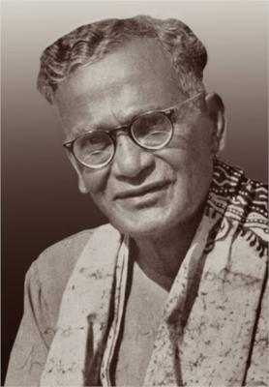
Nandalal Bose
1882-1966

Slide 3
BENGAL SCHOOL ARTIST
Born – 3 December 1882 Kharagpur Bihar
Died - 16 April 1966
Known for - Painting , Printmaker
Awards - Padam Vibhushan

Slide 4
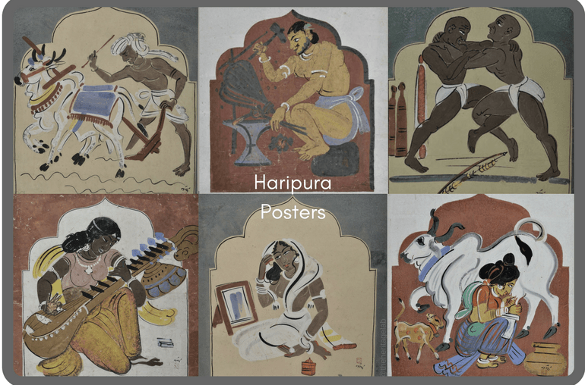
Haripura Posters

Slide 5
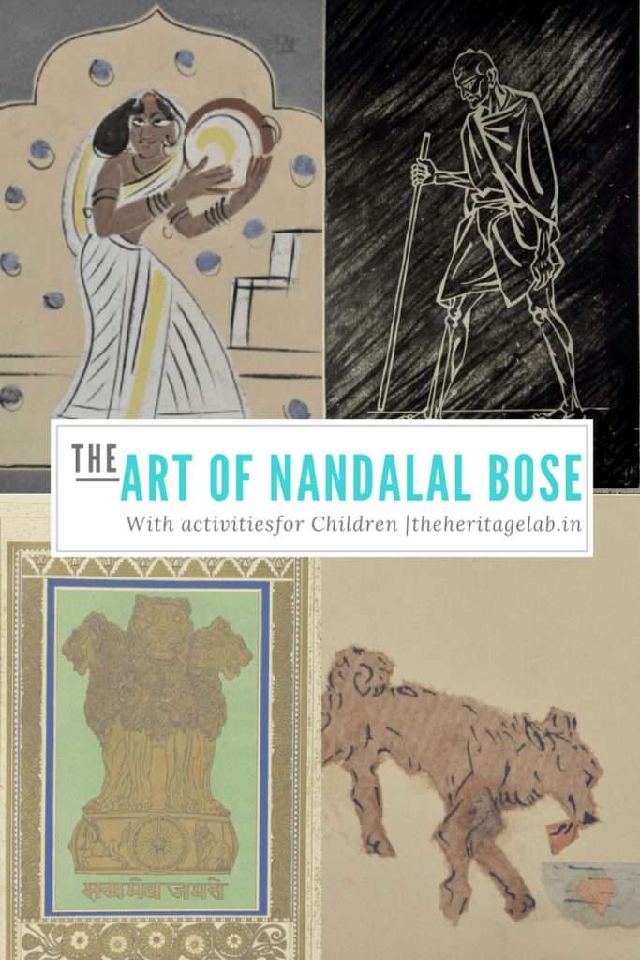
Nandalal Bos
Work

Slide 6
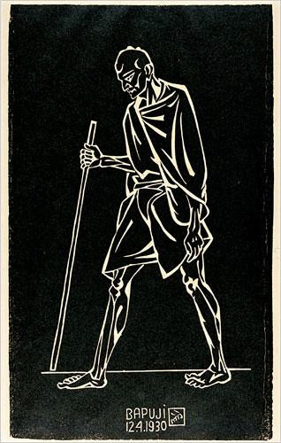
Dandi March
Woodcut print on Paper
1930

Slide 7
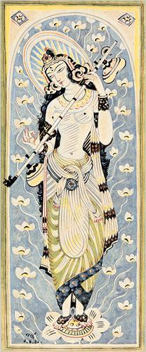
Saraswati
1941

Slide 8
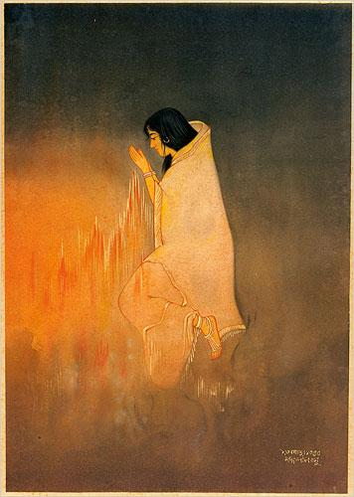
Sati
1943

Slide 9
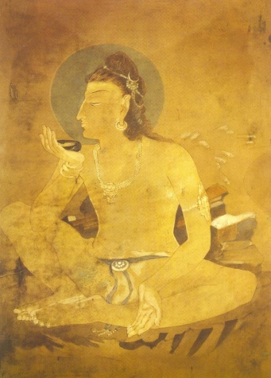
Siva Drinking World Poison

